Slide 1
Extend and Customize SharePoint
SharePoint Framework web parts.
SharePoint Framework extensions.
Package and deploy a SPFx solution.
Consumption of Microsoft Graph.
Consumption of third-party APIs secured with Azure AD from within SPFx.
Web Parts as Teams Tabs.
Branding and theming in SharePoint

Slide 2
SharePoint Framework web parts

Slide 3
Introduction to SharePoint Framework
SharePoint Framework is the development model used for the creation of custom experiences for SharePoint and Office 365.
Use SharePoint Framework (SPFx) to create the following:
SharePoint Framework (SPFx) web parts.
SPFx extensions.
Single Part App Pages.
Microsoft Teams customizations.
Key features of the SharePoint Framework.
Notes:
The SharePoint Framework (SPFx) is a page and web part model that provides full support for client-side SharePoint development, easy integration with SharePoint data, and support for open source tooling.

Slide 4
SharePoint Framework development tools & libraries
SharePoint Framework includes several client-side JavaScript libraries you can use to build your solutions.
The tools and libraries used to develop client-side web parts include:
TypeScript.
JavaScript frameworks (e.g. React, Angular, Vue.js, Handlebars).
Node Package Manager (npm).
Node.js.
Gulp task runner (use to build packages and solutions).
Webpack.
Source code editors (e.g. Visual Studio Code, Atom, WebStorm).
SharePoint REST APIs.
Patterns and Practices (PnP).
Yeoman generators.
Generate SharePoint Framework Projects using Yeoman.

Slide 5
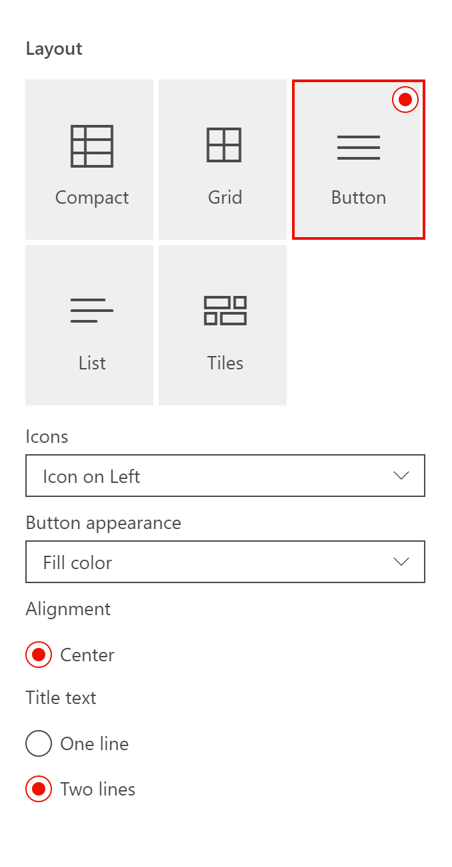
SharePoint client-side web parts
SharePoint client-side web parts are controls that appear inside a SharePoint page but run locally in the browser. Integrate web part properties with SharePoint.
Client-side web part properties.
Property pane field types supported:
Button
Checkbox
Choice group
Dropdown
Horizontal rule
Label
Link
Slider
Textbox
Multi-line Textbox
Toggle
Custom
Configure the property pane.
Notes:
Stress the importance that this is how the user will interact with the webpart. Make sure that options are in a logical order and are consistent with the out of the box (OOTB) options

Slide 6
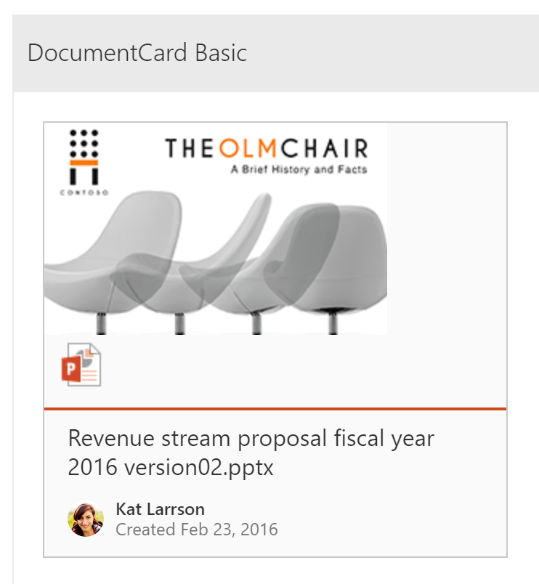
Office UI Fabric React components in SharePoint client-side web part
Two areas of UI Fabric that developers can use:
UI Fabric Core
Colors
Icons
Fonts
Grids
Fabric React Components: A series of reusable components
Buttons
Navigation
Dropdowns
Labels

Slide 7
Office UI Fabric React components in SharePoint client-side web part
Using Office UI Fabric Core and Fabric React in SharePoint Framework.
Office UI Fabric Core package.
Office UI Fabric React components.
The CSS challenge with Office UI Fabric.

Slide 8
Single part app pages
Single part app pages provide the ability to host SharePoint Framework web parts or Teams applications in SharePoint Online with a locked layout. End users cannot modify or configure a page that uses the Single Part App Page layout.
App pages have following characteristics:
Single Part App Pages cannot be edited by end users using a browser.
Currently support hosting only single web part or Microsoft Teams application.
Page layout can only be changed programmatically from normal page layout to a Single Page App Page.
End-users cannot parameterize exposed web part or Teams application.
Use the Single Part App page in your tenant.
Change Page layout using JavaScript in browser console.
Change page layout using PnP PowerShell.

Slide 9
Demo
Introduction to SharePoint Framework (SPFx)
Notes:
Demo Resources Found Here: https://microsoft.sharepoint.com/:w:/t/MOCtoBaselineevents/ERBwiD99TRdKhhQ-7nElZDcBamvEVtrmLDj-4xCUW57_ug?e=fR6170

Slide 10
SharePoint Framework extensions

Slide 11
SharePoint Framework extensions
SharePoint Framework extensions allow you to extend the development capabilities of SharePoint and Teams.
Three specific types of extensions.
Application Customizers: Adds scripts to the page and accesses well-known HTML element placeholders and extends them with custom renderings.
Command Sets: Extends the SharePoint command surfaces to add new actions and provides client-side code that you can use to implement behaviors.
Field Customizers: Provides modified views to data for fields within a list.
Notes:
SharePoint Framework (SPFx) extensions are client-side components that run inside the context of a SharePoint page. You can deploy extensions to SharePoint Online, and you can use modern JavaScript tools and libraries to build them.

Slide 12
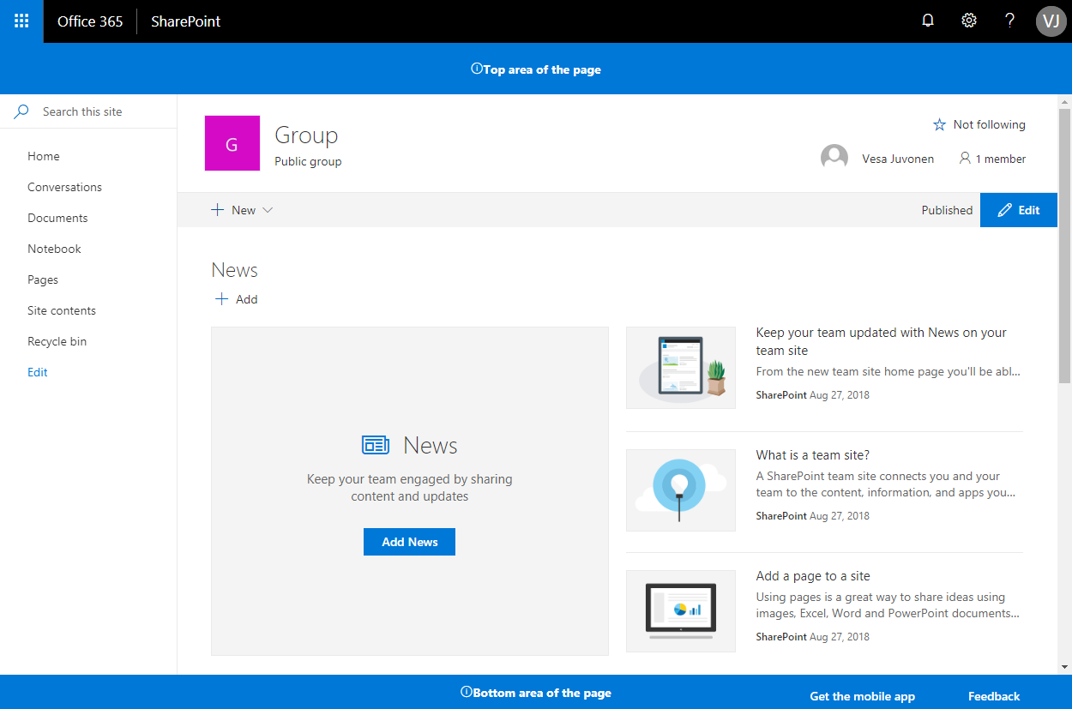
The Application Customizer extension
Application Customizers provide access to well-known locations on SharePoint pages that you can modify based on your business and functional requirements.

Slide 13
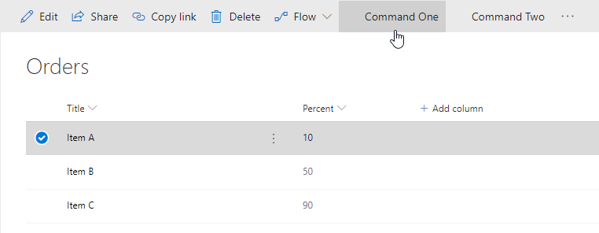
The ListView Command Set extension
ListView Command Set extension allows you to add custom controls and functionality within the Command Bar at the top of the page.
Notes:
https://github.com/SharePoint/sp-dev-fx-extensions/tree/master/samples/js-command-clone

Slide 14
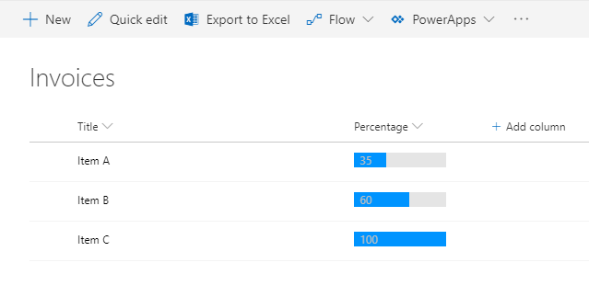
The Field Customizer extension
Field Customizer extensions allow you to customize how specific fields render within a SharePoint List.
Examples:
Status
Percentage

Slide 15
Demo
Creating SharePoint Framework Extensions
Notes:
Demo Resources Found Here: https://microsoft.sharepoint.com/:w:/t/MOCtoBaselineevents/EbetfHzQqwNAr8EY7NPVO-UBS79TO27J_9Ur_nuT_xQHiw?e=JYGf60

Slide 16
Package and deploy a SPFx solution

Slide 17
Prepare a package for deployment
At times, developers may need to provision a SharePoint list or a document library along with your client-side solution package so that the list or library is available for your client-side components, such as web parts.
Provision SharePoint assets with your solution package.
Create SharePoint items in your solution.
Upgrade SharePoint items.
Update SharePoint Framework packages.

Slide 18
Package a solution
Each package configuration file includes some optional settings to override the places where the task looks for various source files and manifests, as well as defining the location to write the package. Additionally, it includes a required solution definition, which instructs the packager on the relationships between various components.
Solution definition (ISolution).
Feature definition (IFeature).
File paths.

Slide 19
Tenant-scoped solution deployment
The Tenant-Wide Deployment option for SharePoint Framework extensions is supported for application customizers and for ListView Command Sets. It provides tenant app catalog managers with an easy option for managing which extensions are activated by default across the tenant or based on web/list templates used in the sites.
Tenant-scoped solution deployment option.
Solution-specific requirements.
Configure solution to be available across the tenant.
Approve tenant-wide deployment in app catalog.

Slide 20
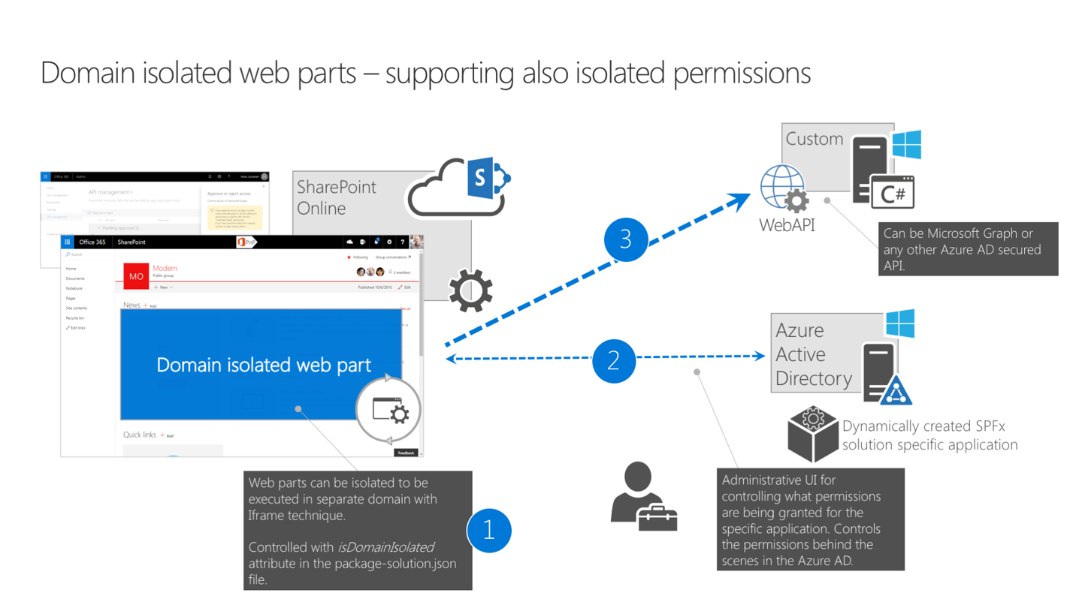
Domain isolated web parts

Slide 21
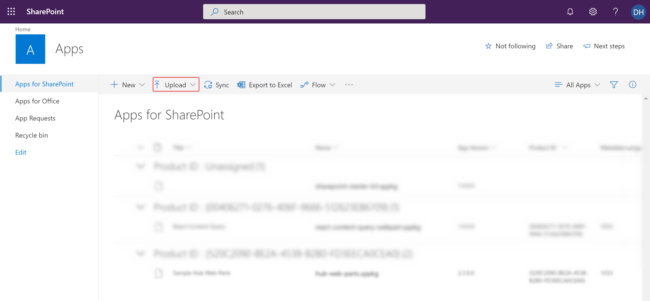
Optimize SharePoint Framework builds for production
Package the solution using the following commands, then upload into the app catalog for SharePoint.
gulp build
gulp bundle –ship
gulp package-solution –ship

Slide 22
Demo
Deploying a SharePoint Framework Solution
Notes:
Demo Resources Found Here: https://microsoft.sharepoint.com/:w:/t/MOCtoBaselineevents/ERGPKlWSe6tCr4Gxh7550ccBBaoRNxTbc4WOr7-QVQOZRw?e=1H4Ian

Slide 23
Consumption of Microsoft Graph and third-party APIs

Slide 24
Use the MSGraphClient to connect to Microsoft Graph
When building SharePoint Framework solutions, developers can easily connect to Microsoft Graph by using the MSGraphClient.
MSGraphClient is a new HTTP client introduced in SharePoint Framework v1.6.0 that simplifies connecting to the Microsoft Graph inside SharePoint Framework solutions.
MSGraphClient wraps the existing Microsoft Graph JavaScript Client Library, offering developers the same capabilities as when using the client library in other client-side solutions.
Notes:
MSGraphClient wraps the existing Microsoft Graph JavaScript Client Library, offering developers the same capabilities as when using the client library in other client-side solutions.

Slide 25
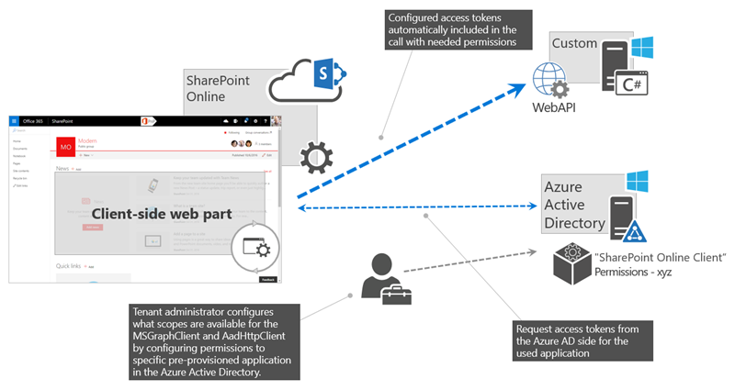
Understand AadHttpClient
SharePoint Framework allows you to specify which Azure AD applications and permissions your solution requires, and a tenant administrator can grant the necessary permissions if they haven't yet been granted.
By using the AadHttpClient, you can easily connect to APIs secured by using Azure AD without having to implement the OAuth flow yourself.

Slide 26
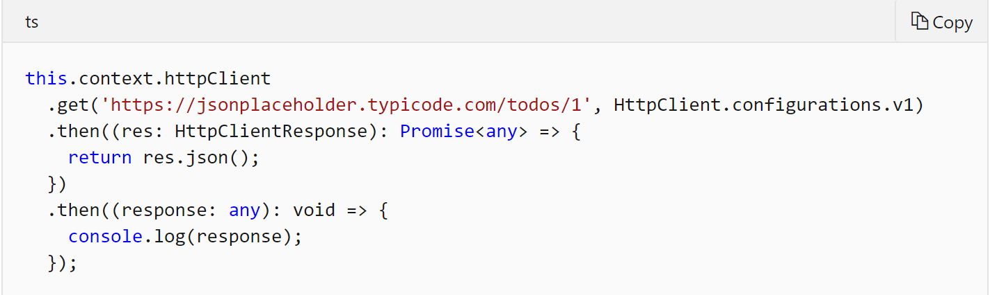
Grant permissions to consume a third-party API
When building SharePoint Framework solutions, you might want to consume public APIs, such as stock or weather information.

Slide 27
Branding and theming in SharePoint

Slide 28
SharePoint site theming
Like the Microsoft brand palette, the SharePoint themes are designed to build on the Microsoft brand, while at the same time allowing for flexibility to enliven your partnerships without dominating them. They reveal shared goals and personality, and they reflect diversity and ability to optimize the SharePoint experience.
Notes:
Explain SharePoint site theming.
https://fabricweb.z5.web.core.windows.net/pr-deploy-site/refs/heads/master/theming-designer/index.html

Slide 29
SharePoint site theming
Theming experience components:
Color palette.
Font scheme.
Background image.
Master page.
Master page preview.
Composed look.
Change the look.
Design gallery.

Slide 30
Site design and site scripts
Use site designs and site scripts to automate provisioning new or existing modern SharePoint sites that use your own custom configurations.
Site designs.
Site script.
Use PowerShell or REST to work with site designs an site scripts.
Scoping.

Slide 31
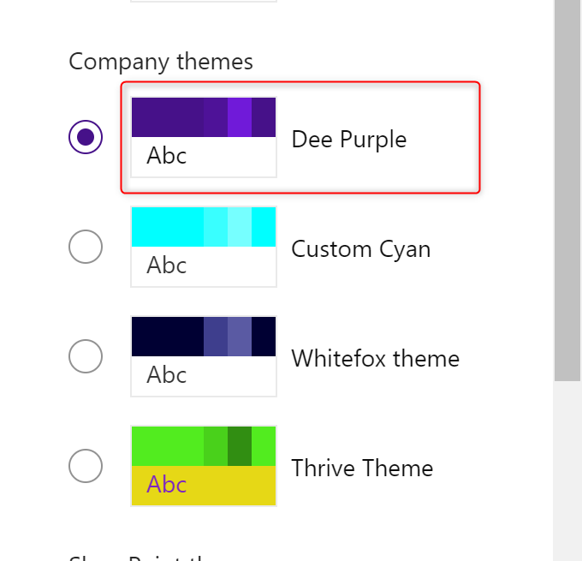
Site design and site scripts
Notes:
Site Design GitHub Examples
https://github.com/SharePoint/sp-dev-site-scripts

